Slide 1

Chapter Six
Advanced JavaScript and XML (AJAX)

Slide 2
Outline
Introduction to AJAX
XMLHttpRequest Object
Sending Request to PHP server
Handling Response from Server

Slide 3
What is Ajax?
Ajax is an acronym for Asynchronous JavaScript and XML.
It is used to communicate with the server without refreshing the web page and thus increasing the user experience and better performance.
Each action sends data and receives results in the background.
Notes:
An excellent example of this technology is Google maps, in which new sections of a map are downloaded from the server when needed, without requiring a page refresh.

Slide 4
Synchronous vs Asynchronous
Synchronous (Classic Web-Application Model)
Synchronous request blocks the client until operation completes i.e. browser is unresponsive.
In such case, JavaScript engine of the browser is blocked.
Notes:
when synchronous request is made from the client to the server, the client's browser waits for the operation to complete before proceeding further. This can cause the browser to become unresponsive, as it waits for the server to respond. During this time, the JavaScript engine of the browser is indeed blocked, meaning that any other JavaScript code that should be executed in the browser will also be halted until the synchronous operation completes. This can lead to a poor user experience, especially in cases where the operation takes a significant amount of time to complete.

Slide 5
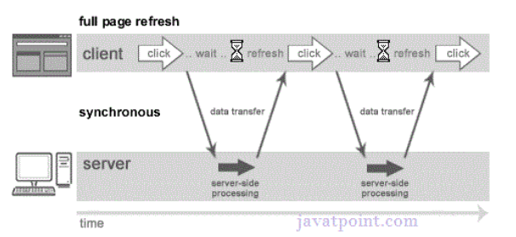
Cont.…
As you can see in the image, full page is refreshed at request time and user is blocked until request completes.

Slide 6
Asynchronous(AJAX Web-Application Model)
Asynchronous request doesn’t block the client i.e. browser is responsive.
At that time, user can perform another operations also.
In such case, JavaScript engine of the browser is not blocked.
full page is not refreshed at request time and user gets response from the ajax engine
Notes:
In asynchronous web application model, when a request is made from the client to the server, the browser does not wait for the operation to complete before moving on. Instead, it continues to execute other tasks, allowing the user to interact with the page without interruption. This means that the JavaScript engine of the browser is not blocked, and other operations can be performed simultaneously.
Asynchronous requests are typically handled using techniques such as AJAX (Asynchronous JavaScript and XML), where the browser can make requests to the server and receive responses dynamically without having to reload the entire page. This leads to a more responsive and interactive user experience, as only specific parts of the page are updated when needed, rather than refreshing the entire page.

Slide 7
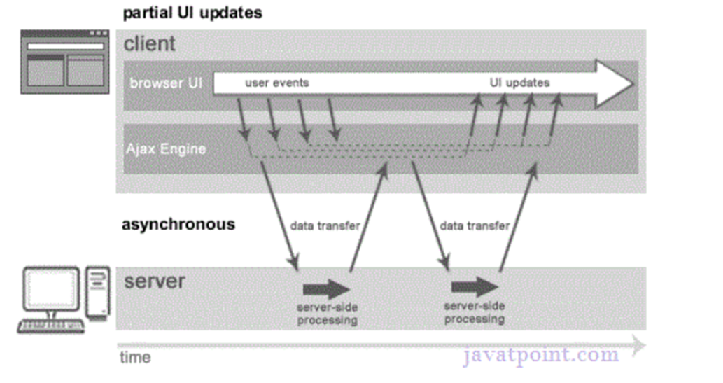
Cont..

Slide 8
AJAX Technologies
AJAX technologies includes:
HTML/XHTML and CSS
DOM
XML or JSON
XMLHttpRequest
JavaScript

Slide 9
Cont..
HTML/XHTML and CSS
These technologies are used for displaying content and style. It is mainly used for presentation.
DOM
It is used for dynamic display and interaction with data.
XML or JSON
For carrying data to and from server. JSON (JavaScript Object Notation) is like XML but short and faster than XML.
JavaScript
Binding everything together

Slide 10
XMLHttpRequest
XMLHttpRequest object is used for asynchronous communication between client and server.
It performs following operations:
Sends data from the client in the background
Receives the data from the server
Updates the webpage without reloading it.

Slide 11
Properties of XMLHttpRequest object
Property | Description
onReadyStateChange | It is called whenever readystate attribute changes.
readyState | It ranges from 0 to 4. 0 UNOPENED open() is not called. 1 OPENED open is called but send() is not called. 2 HEADERS_RECEIVED send() is called, and headers and status are available. 3 LOADING Downloading data; responseText holds the data. 4 DONE The operation is completed fully.
reponseText | returns response as text.
responseXML | returns response as XML
Notes:
When an Ajax call successfully completes, the object’s status will have a value of 200
readyState is a property that you check to see the current state of the XMLHttpRequest.
onreadystatechange is an event handler that you define to execute code in response to changes in the readyState.

Slide 12
Methods of XMLHttpRequest object
Method | Description
void open(method, URL) | opens the request specifying get or post method and url
Void open(method, URL, async) | same as above but specifies asynchronous or not
Void open(method, URL, async, username, password) | same as above but specifies username and password
void send() | sends get request
void send(string) | send post request
SetRequestHeader(header, value) | it adds request headers.

Slide 13
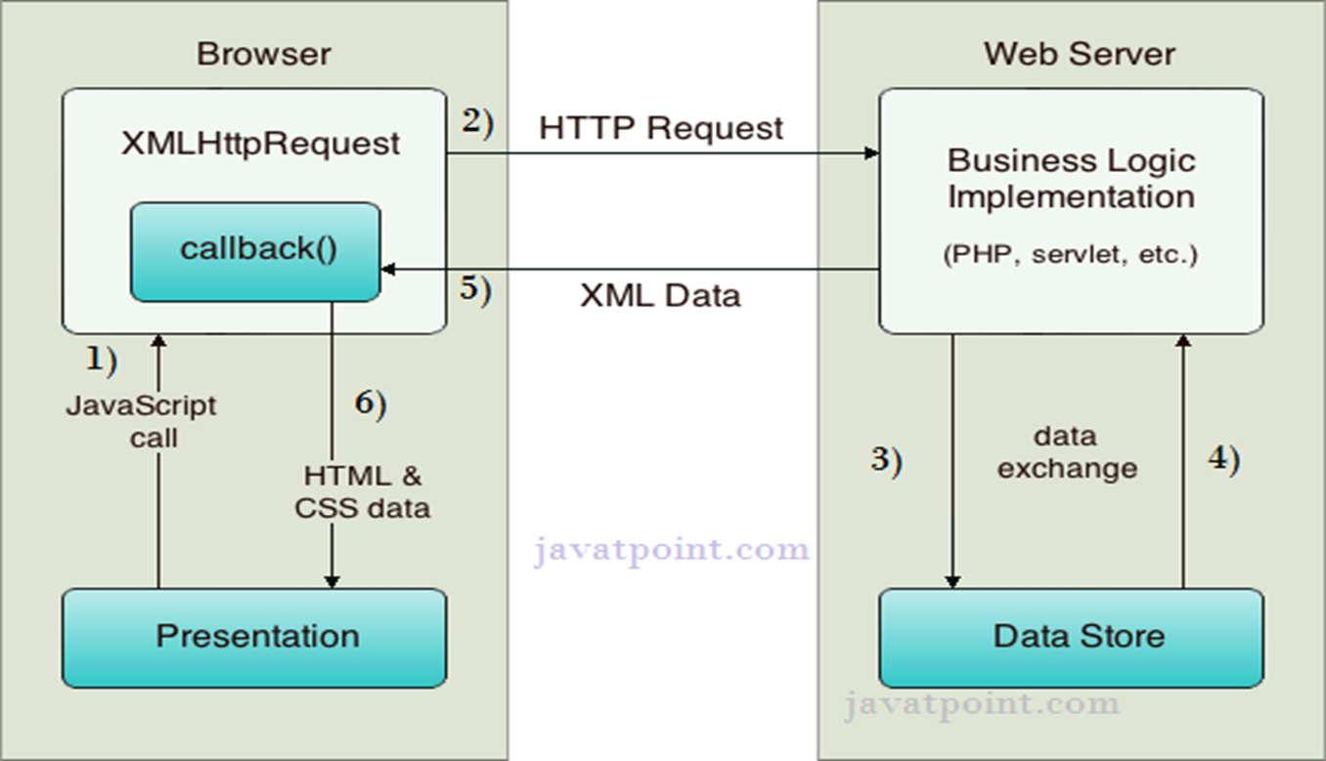
How AJAX works?
AJAX communicates with the server using XMLHttpRequest object.
Notes:
HTTP requests are sent using the XMLHttpRequest object.
User sends a request from the UI and a JavaScript call goes to XMLHttpRequest object.
HTTP Request is sent to the server by XMLHttpRequest object.
Server interacts with the database using JSP, PHP, Servlet, ASP.net etc.
Data is retrieved.
Server sends XML data or JSON data to the XMLHttpRequest callback function.
HTML and CSS data is displayed on the browser.

Slide 14
Cont.…
As you can see in the above example, XMLHttpRequest object plays a important role.
User sends a request from the UI and a JavaScript call goes to XMLHttpRequest object.
HTTP Request is sent to the server by XMLHttpRequest object.
Server interacts with the database using JSP, PHP, Servlet, ASP.net etc.
Data is retrieved.
Server sends XML data or JSON data to the XMLHttpRequest callback function.
HTML and CSS data is displayed on the browser.

Slide 15
Example
<!DOCTYPE html>
<html lang="en">
<head>
<meta charset="UTF-8">
<title>AJAX Example</title>
</head>
<body>
<p id="demo">AJAX change this text.</p>
<button type="button" onclick="loadDoc()">Change Content</button>
<script>
function loadDoc() {
// Create a new XMLHttpRequest object
var xhttp = new XMLHttpRequest();
…
Notes:
the onreadystatechange callback is designed to be triggered asynchronously whenever the readyState changes.
Thus, xhr.send() starts the request, and the response handling occurs later, as defined by the callback function.

Slide 16
Example
…
// Define the function to be called when the readyState changes
xhttp.onreadystatechange = function() {
// Check if the request is complete (readyState is 4) and successful (status is 200)
if (this.readyState == 4 && this.status == 200) {
// Update the content of the paragraph with the ID 'demo'
document.getElementById("demo").innerHTML = this.responseText;
}
};
// Initialize the request
xhttp.open("GET", "labone.php", true);
// Send the request
xhttp.send();
}
</script>
</body>
</html>
Notes:
the onreadystatechange callback is designed to be triggered asynchronously whenever the readyState changes.
Thus, xhr.send() starts the request, and the response handling occurs later, as defined by the callback function.

Slide 17
Cont.…
<?php
// labone.php
// Set the content type to text/plain (you can change this to text/html or application/json depending on your needs)
header('Content-Type: text/plain');
// Return a simple text response
echo "Hello, this is the new content loaded via AJAX!";
?>
Notes:
Real-Time Form Data Validation
Form data that require server-side validation can be validated in a form “before” the user submits it.
Auto completion
A specific portion of form data may be auto-completed as the user types.
Master Details Operations
Based on a client event, an HTML page can fetch more detailed information on data without refreshing the page.
Sophisticated UI Controls
Controls such as tree controls, menus, and progress bars may be provided without page refreshes.

Slide 18
Cont.…
Create an XMLHttpRequest Object:
The first step in making an AJAX request is to create an instance of the XMLHttpRequest object. This object is used to interact with servers.
var xhr = new XMLHttpRequest();
Configure the Request: Next, you need to specify the type of request (GET, POST, etc.), the URL of the server endpoint, and whether the request should be asynchronous (true) or synchronous (false). Most AJAX requests are asynchronous.
xhr.open('GET', 'https://api.example.com/data', true);

Slide 19
Cont.…
Set Request Headers (Optional): If necessary, you can set HTTP request headers using the setRequestHeader method. For example, if you're sending JSON data, you might set the Content-Type header to application/json.
xhr.setRequestHeader('Content-Type', 'application/json');

Slide 20
Cont.…
Handle the Response: You need to define a callback function to handle the server's response. This function will be called when the state of the XMLHttpRequest changes. The readyState property indicates the current state of the request, and the status property indicates the HTTP status code of the response.
xhr.onreadystatechange = function() {
if (xhr.readyState === 4 && xhr.status === 200) {
var responseData = JSON.parse(xhr.responseText);
console.log(responseData);
}
};

Slide 21
Cont.…
Send the Request: you send the request using the send method. If you're sending data (as in a POST request), you include the data as an argument to the send method. For a GET request, you typically do not send any data.
xhr.send();

Slide 22


